Slide 2
...the system that works anywhere, anytime for anyone.
What is...
Comprehensive
Customisable
Real Results

Slide 3
The 4 Components of TLS...
Low-glycaemic Impact Eating
Supplementation
Body Composition
Education
#FINDYOURFIT

Slide 4
Low Glycaemic Impact Eating...
Eating right, not less
Keep your body in fat burning zone
Maintain lean muscle mass
Cardiovascular Health
#FINDYOURFIT

Slide 5
Body Composition...
Fat loss
Muscle dictates metabolism
Repair and increases metabolism
Enhance results with exercise
#FINDYOURFIT

Slide 6
Supplementation...
Support a healthy metabolism
Carbohydrate sensitivity
Poor dietary habits
Supports hormones
Designed to work together with behaviour changes to maximise your success.
#FINDYOURFIT

Slide 7
Education...
Teaches you how to eat
Help change your habits to improve your health
Discover why you struggled to lose weight before
Learn how to maintain your success long term
#FINDYOURFIT

Slide 8
TLS 21-DAY
CHALLENGE
A simple, short term programme designed for fast, effective weight management
#TLS21DAYS
START LIVING WITH TLS TODAY
Notes:
Brief introduction and play the video clip

Slide 9
Why take the 21 Day Challenge...
Take the Challenge if you want to…
Tone up
Address the essentials of effective weight management
Jumpstart a long-term TLS weight management journey
#TLS21DAYS

Slide 10
Amy
Changes in 21 days!
Weight: 3.4lb Waistline: 1.5”
Body Fat: 4.7% Abdomen: 1.0”
Results shown above may not be typical.
Individual results may vary.

Slide 11
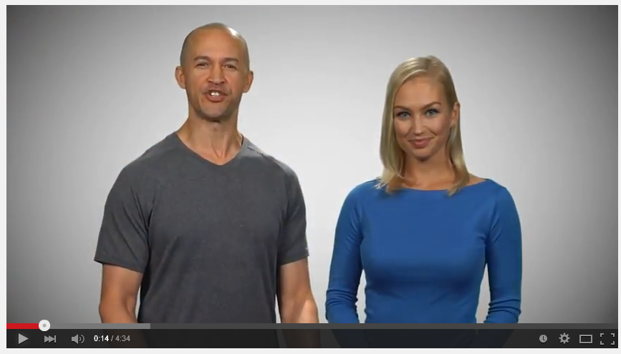
21 Day Challenge Overview Video – sg.tlsSlim.com
Just send the link for the 5-minute video to those who are interested!!
#TLS21DAYS

Slide 12
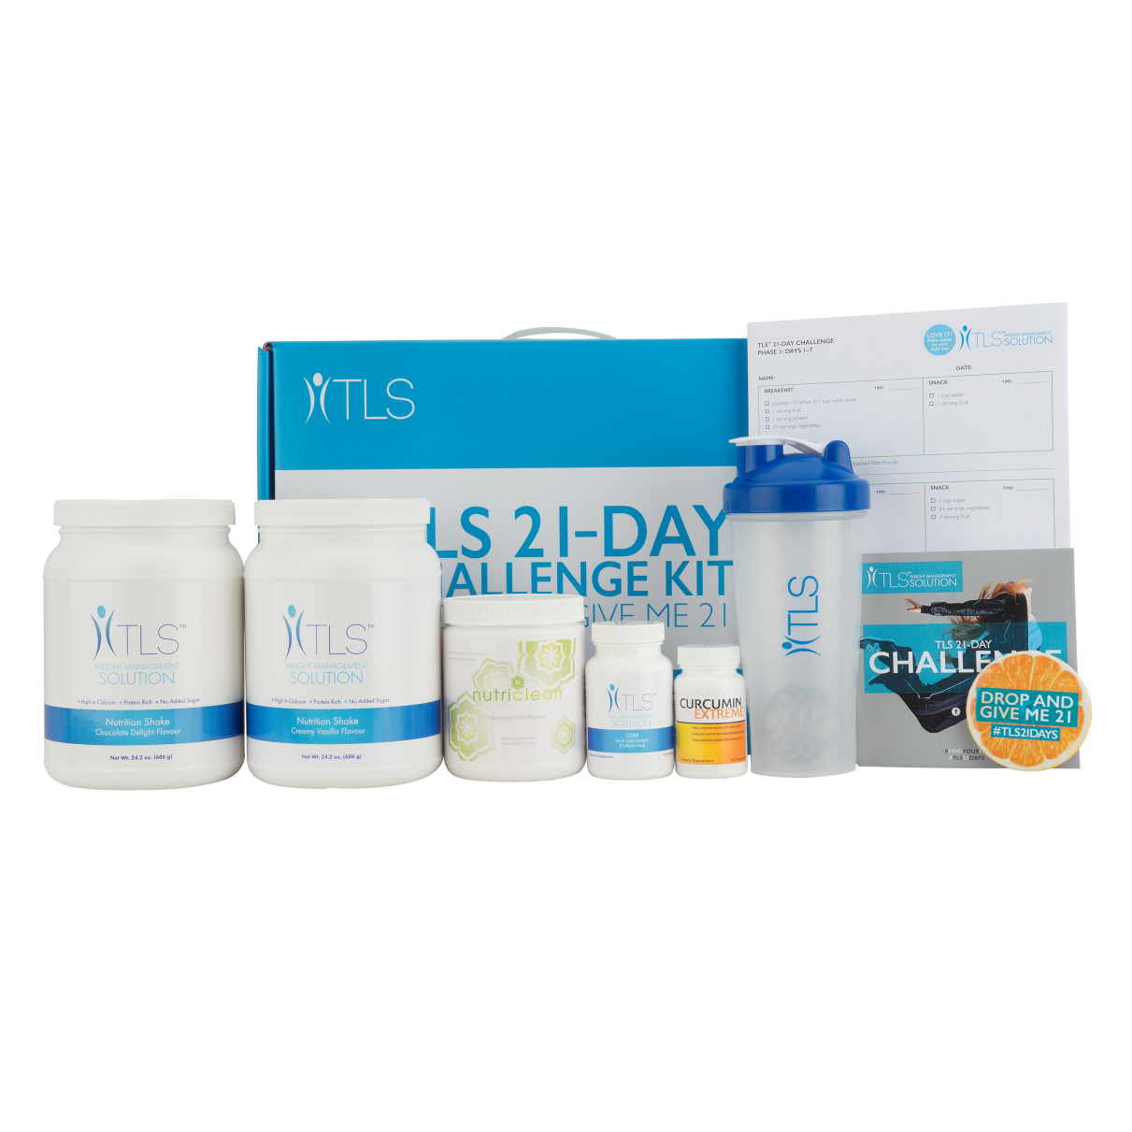
Savings for your Customers > S$83.45
Code: SG21DAY
UC: S$186.00
SR: S$260.50
BV: 25
#TLS21DAYS
Notes:
2 shakes, fiber powder, curcumin, core

Slide 13
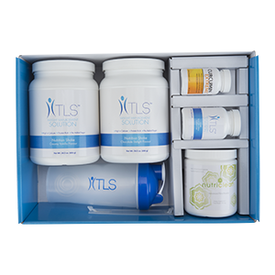
21 DAY CHALLENGE SUPPORT MATERIALS: Found in kit, unfranchise.com &
sg.tlsSlim.com
The 21 Day Challenge Guide
Coaches Training Guide
Videos
Social Media Images
Tracking Sheet
Recommended Supplements
FAQs
Infographics
#TLS21DAYS

Slide 14
2017 TLS 21 Day Monthly Goal Challenge
New winner each month wins USD$100 SHOP.COM gift card
All 12 2017 winners compete for USD$1000 SHOP.COM gift card
Top 3 are voted for on social media from the 3rd – 8th of each month
Must start and finish within the given month
Promote this each month for them to start when the new month turns
#TLS21DAYS

Slide 15
Substantial Profit Margin
Boost your profit
Grow your customer base
Cost Effective
Easy to sell and explain
Short Term Commitment
Why should you sell the 21 Day Challenge?

Slide 16
What happens after 21 days?
If customers want to continue their weight management journeys, we recommend that they take our FREE Weight Management Profile on sg.tlsSlim.com. This will determine the best long term weight management solution for them & the best products to order.
As they’re reaching their goal, ask them to consider becoming a TLS Coach. Being a part of the weight management industry and helping others reach their goals is a great way to stay on track.
#TLS21DAYS

Slide 17
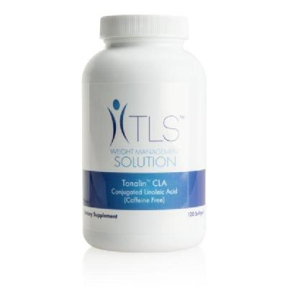
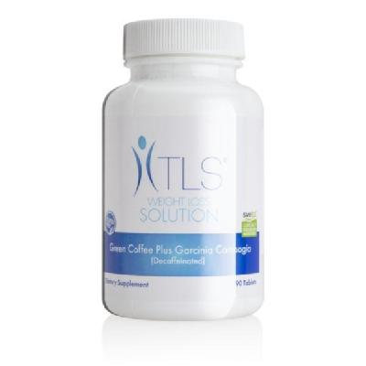
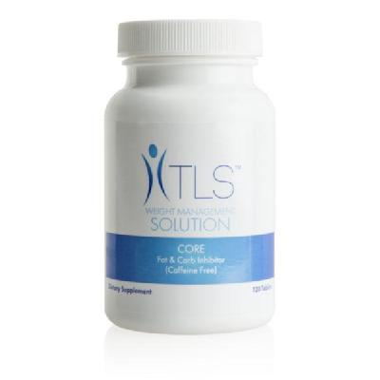
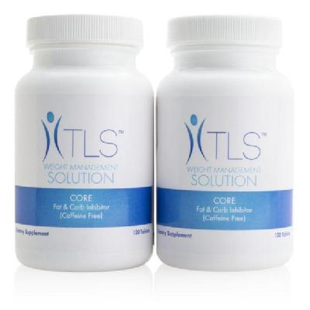
Other TLS Products to Support Your Customers
TLS Tonalin™ CLA
(Conjugated Linoleic Acid)
TLS™ Green Coffee Plus
Garcinia Cambogia
TLS™ Nutrition Shakes
SAVE 25%
TLS™ CORE Fat & Carb
Inhibitor
TLS™ CORE Twin Pack
TLS™ Detox Kit

Slide 18
Lepticore 8-Week Study Results - 300 mg 2x/day
Weight decreased 5.4% - (11.6 lbs), Body fat decreased 2.8%, Waist circum. decreased 4.4% - (1.8”), Hip circum. decreased 3.5% - (1.7”)
Total Cholesterol | ↓ 18.0% |  | Fasting Blood Glucose | ↓ 7.9%
LDL Cholesterol | ↓ 14.7% |  | Serum Serotonin | ↑ 28.6%
HDL Cholesterol | ↑ 13.7% |  | Serum Leptin Levels | ↓ 46.9%
Plasma Triglycerides | ↓ 7.1% |  | C-Reactive Protein Levels | ↓ 15.1%
Kuate, et al., Lipids in Health and Disease, 2010, 9:20

Slide 19
sg.tlsSlim.com

Slide 20
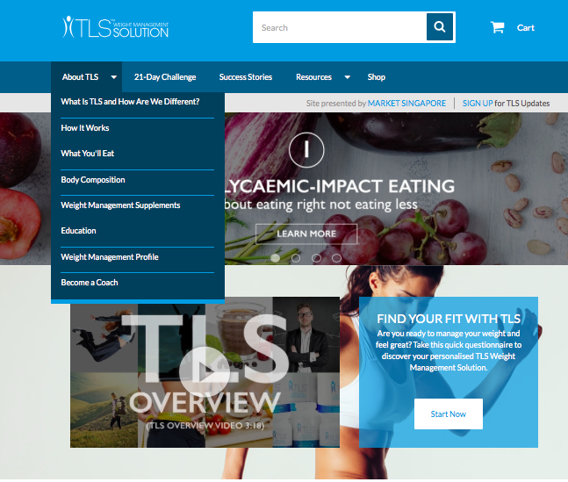
Notes:
The about TLS tab offers different topics, including the new prospecting tab “become a coach”

Slide 21
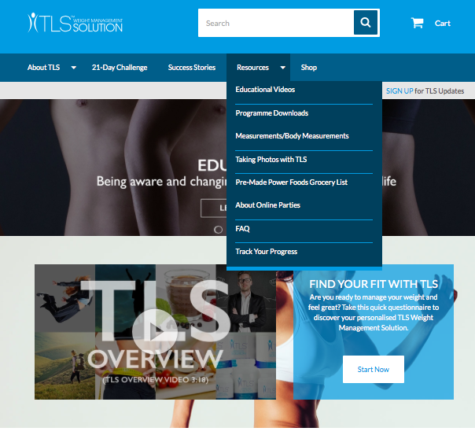
Notes:
The resources tab will have everything you need to succeed including your educational videos, TLS menu plans and now the new track your progress where your fit bit will link directly to your site, when you're logged in!

Slide 22
View and Download TLS Videos on Youtube.com
Notes:
All videos are available on youtube, including what is tls and the 10 minute TLS overview! With this site, you’re entire team can benefit because the site is equipped with all the questions a new customer may have.

Slide 23
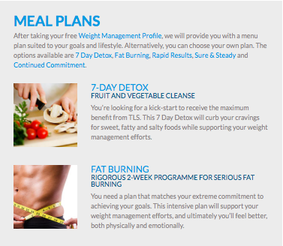
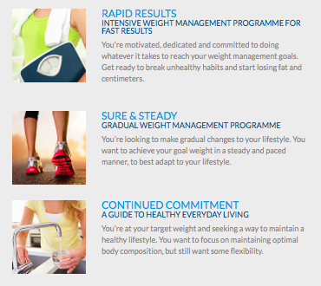
Other sg.tlsSlim.com Features: Menu Plans
Notes:
Clean and easy to print tls menu plans as well as a way to link your fit bit to your tlsslim.com page

Slide 24
Education, Social Media Links and More!

Slide 25
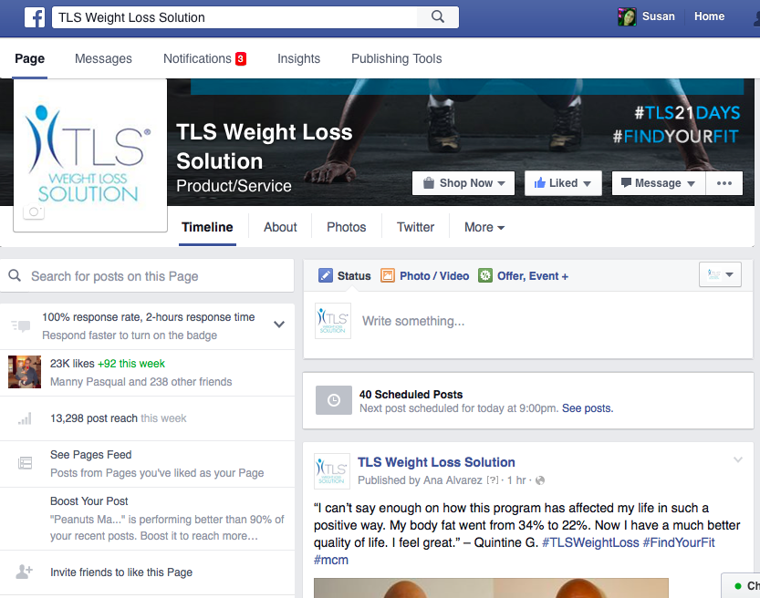
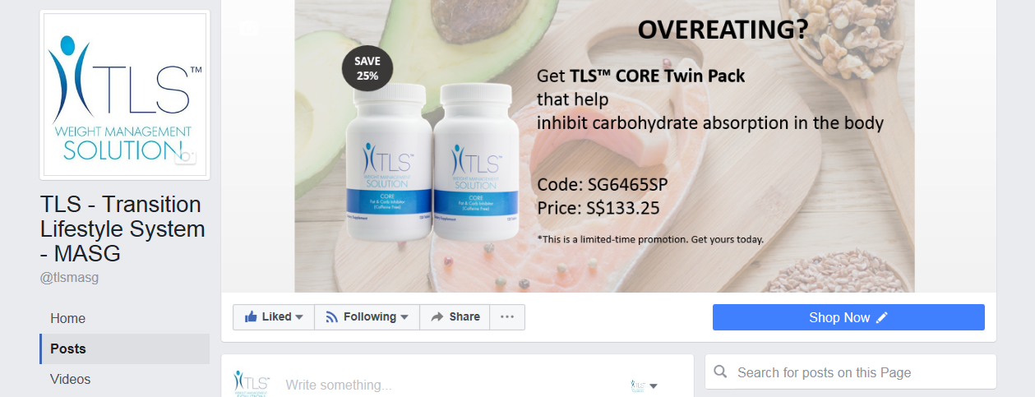
Facebook.com/tlsweightloss
Facebook.com/tlsmasg
Notes:
Be sure to follow us @tlsweightloss on all social media and invite all your customers to follow our general page too! This page is great for anyone to ask questions about TLS but also to receive tips, motivation, recipe ideas and support from anyone involved with TLS!

Slide 26
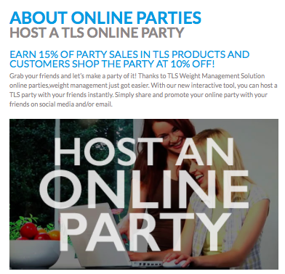
Become a Coach & TLS Online Party

Slide 27
TLS™ Coaches Guide
Coming Soon
WEIGHT MANAGEMENT
SOLUTION
WEIGHT MANAGEMENT
SOLUTION
#FINDYOURFIT
#TLSWEIGHTMANAGEMENT

Slide 28
What is the TLS™ Coaches Guide?
Guide to support you while coaching your first TLS clients
Guide to assist you with how to run programmes and groups
Guide to help you build confidence
Guide that gives Q&A’s to use in your groups
Provides week-by-week guidance
#FINDYOURFIT
#TLSWEIGHTMANAGEMENT

Slide 29
Why was the TLS™ Coaches Guide created?
Many new coaches don’t know where to start
New coaches may not have a TLS mentor
Many TLS leaders have developed their own guide with their teams – this guide works for everyone!
Printable to take with you when you coach
Gives suggestions of emails to send to clients and allows coaches to copy, paste and add or delete their own personal items
#FINDYOURFIT
#TLSWEIGHTMANAGEMENT

Slide 30
Education Coupled with sg.tlsSlim.com?
AVAILABLE NOW
TLS™ Journal (Hard Copy)!
Code: SG6561
UC: S$18.00
SR: S$25.00
TLS Health Guide
Electronic Copy found on unfranchise.com &
sg.tlsSlim.com for download
#FINDYOURFIT
#TLSWEIGHTMANAGEMENT

Slide 31
12 Weeks of Education
Goal Setting & Detox
Low Glycaemic Impact
Reading Labels
Improving Metabolism
Exercise & Body Composition
Planning & Dining Out
Nutrition Basics
Creating Healthy Habits
Overcoming Obstacles
Managing Stress
Assessing Results
Living the TLS™ Lifestyle
Supplement Regimens
#FINDYOURFIT
#TLSWEIGHTMANAGEMENT

Slide 32
Other Educational Topics
Gluten Sensitivity
Self Confidence
Food Addiction
Appetite Control
Remembering where you started & where you never want to go back to
Share your Story
Meal Planning & Grocery Shopping
Sweeteners
Hormones Health & Stress
Why Supplements help
Alcohol
Sleep
#FINDYOURFIT
#TLSWEIGHTMANAGEMENT

Slide 33
TLS™ Make A Difference Contest
3rd PLACE
Verna Tay
2nd PLACE
Angela Hou
WINNER
Tan Song Eng

